Slide 1
ASP.NET MVC CORE
Instructor: Edwin oduor

Slide 2

Quote of the day

Slide 3
Lesson objectives
Views

Slide 4
Lesson pre-requisites
In order to take full advantage of this section you need to have the following;
Computer with Visual Studio Installed.
Stable Network Connection.

Slide 5
Training methods and extra readings
TRAINING METHODS FOR THIS LESSON
EXTRA READINGS
Lecturing Method – This is the main method of training to be adopted in this lesson with illustrations and practical coding examples.
Discussion Method - This method will be adopted periodically whereby learning will be derived principally from the students brainstorming together, rather than from the trainer. Three main types of discussions will be used:
Directed discussion
Developmental discussion
Problem-Solving discussion
Home and Learn C#

Slide 6
VIEWS

Slide 7
We have already created the Models, Controllers now we move to the view, for the forms or tables or contents of the Database to be visible on the browser then a view has to be created, therefore a view is used to display contents to the user on the browser.
To create a view right click on the action method that you want to create the view for, then click on add view, choose empty razor view and give it a name.
The first view that will create is the index view for our register controller and give it the name index.
Once the view is created will have to import the model to the view, then create a form to be shown when the view is called.

Slide 8
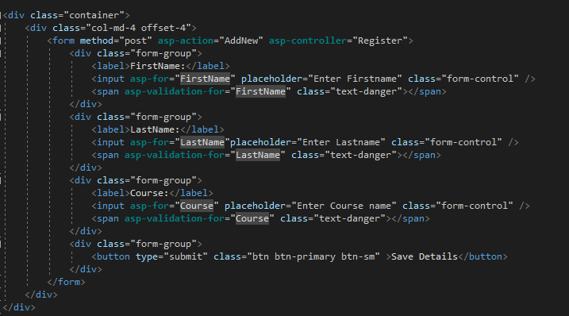
Next is to create a form.
From the above form, the method that we are using is post, action being called is AddNew and controller is Register. When we run our application and the button is clicked on then the Action to be called is the AddNew in the Register controller.

Slide 9
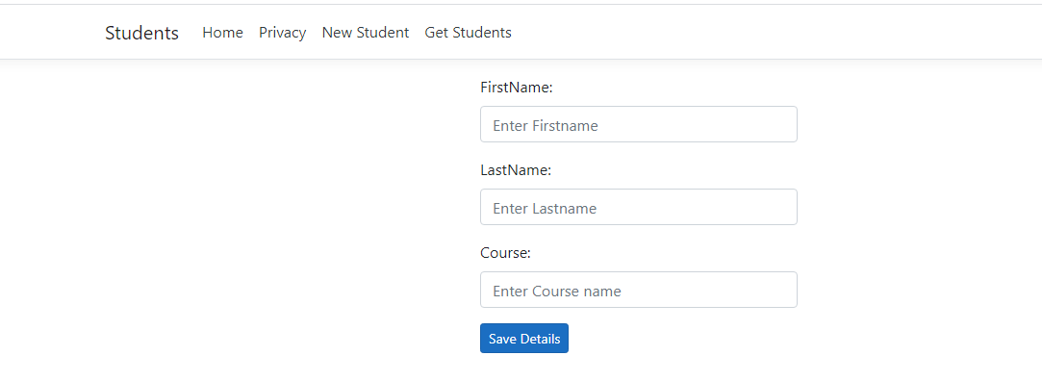
With the code that we have written, when the program is executed it’s going to give us an out put then when new student link is clicked the view will display the form.
Since there is a button and it’s connected to the code to save details in the table, when the button is clicked, the content of what in the textbox is going to be saved in a database.

Slide 10
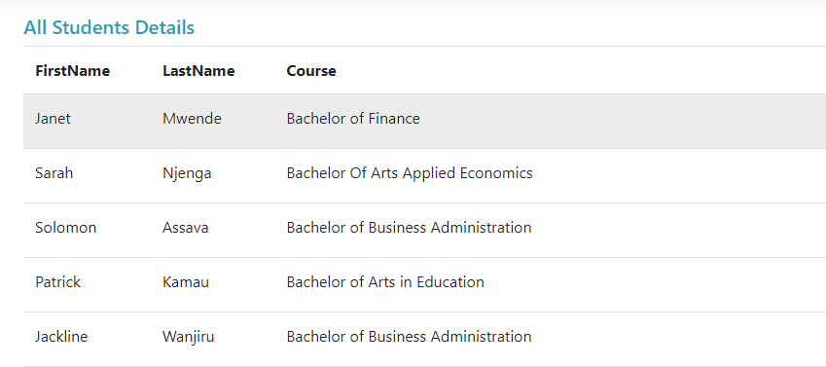
When the Get Students link is clicked it should display for us what we have in the table.

Slide 11
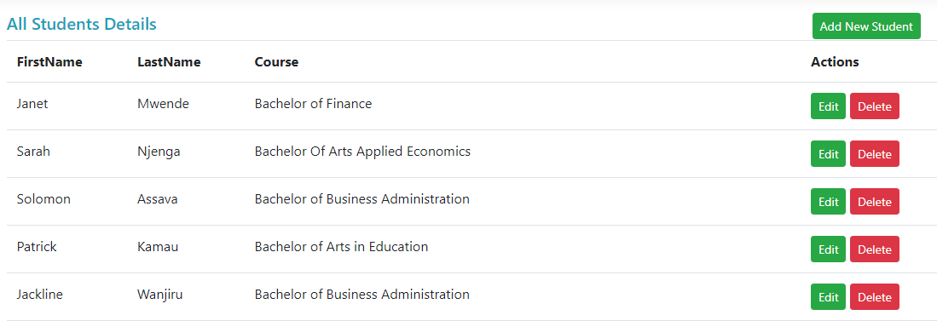
Will go further and add buttons for each item so that we can perform various actions.

Slide 12
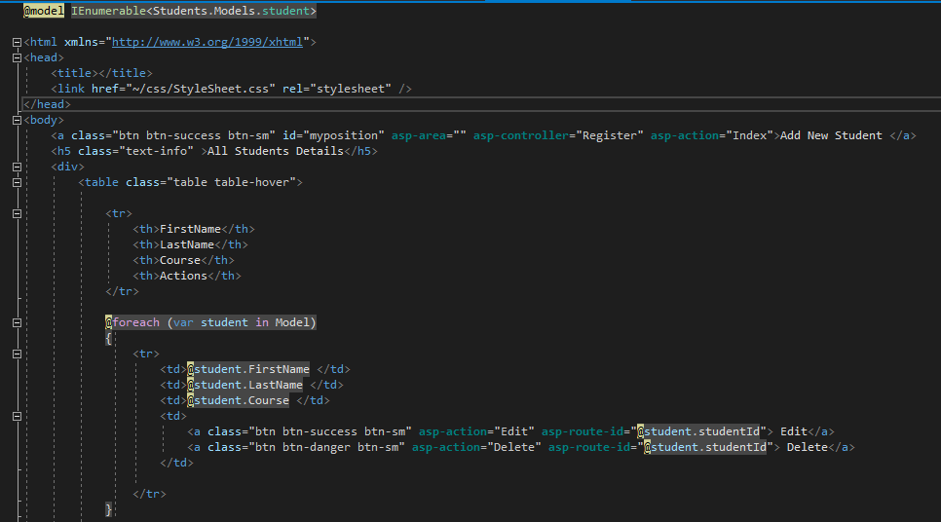
The following code is going to give us the output shown in the previous slide.

Slide 13
VALIDATION

Slide 14
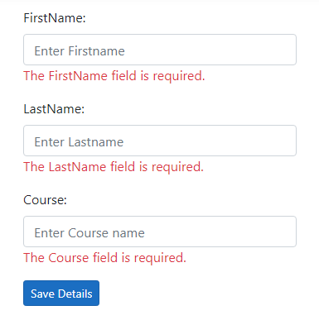
Validation is to check that whatever has been entered is sensible, for instance through validation we can prevent one from entering black text and saving in the database. We want to check if an input is empty then give an appropriate message.

Slide 15
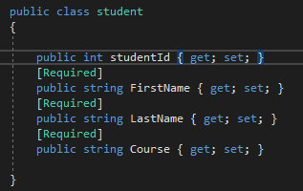
To perform validation will go to the class, that has our fields and decorate them with Required. As shown below.
You will notice that under each input we have asp-validation for – This is the one responsible for displaying the error message when one clicks on the button without anything in the inputs.
Next we have class- text danger that is a bootstrap class that makes the text red in color.

Slide 16
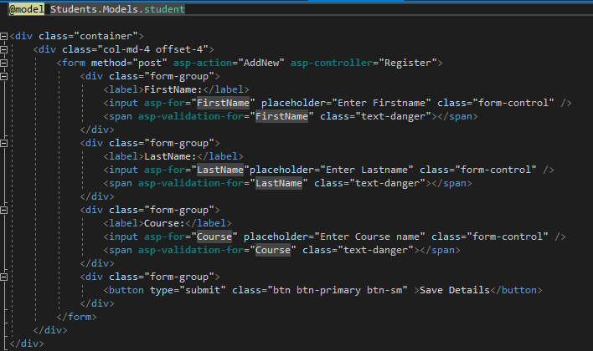
Next will go to our view to write the following so that the error message can be displayed on the browser.

